Slide 1


Lets Grow More
Name: Kritika Gupta
Web Development Internship

Slide 2

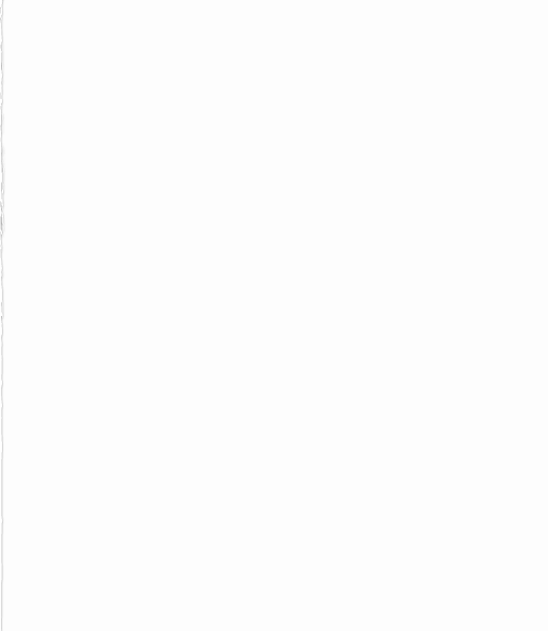
Task 1: TO DO List App
Tech Stack: HTML, CSS, JavaScript, Bootstrap
IDE Used: Atom

Slide 3
Task 2: Create a Web Application using create-react-app
Tech Stack: HTML, CSS, JavaScript
IDE Used: Atom

Slide 4
Task 3: Create a Registration Form whose data display in same page
Tech Stack: HTML, CSS, JavaScript
IDE Used: Atom

Slide 5
Task 4: Create a Calculator
Tech Stack: HTML, CSS, JavaScript
IDE Used: Atom

Slide 6
THANK YOU

